Slide 1
CUSTOMER SEGMENTATION
GUIDED BY:
DR. GOPIKRISHNAN S
PRESENTED BY:
L BHARADHWAJ REDDY
R. NAGA SAI RAM
B N V R ROHITH
D V L SAI SRUTHI

Slide 2
CONTENTS
Abstract
Introduction
Literature Review
Methodology
Data Visualization
Data analysis
conclusion

Slide 3
ABSTRACT
This is where the machine learning comes into picture for better decision making.
The clustering algorithm used is K-means algorithm which is the partitioning algorithm, to segment the customers according to the similar characteristics.
The companies doing the business are also not able to diagnose the target potential customers.
Our project customer segmentation is done using the clustering technique.
The business done today runs on the basis of innovative ideas as there are large number of potential customers who are confused what to buy and what not to buy.
To determine the optimal clusters, elbow method is used.

Slide 4
INTRODUCTION
Sometimes referred to as market segmentation, customer segmentation is a method of analysing a client base and grouping customers into categories or segments which share particular attributes. Key differentials in segmentation include age, gender, education, location, spending patterns and socio-economic group. Relevant differentials are those which are expected to influence customer behaviour in relation to a business. The selected criteria are used to create customer segments with similar values, needs and wants.
When planning a targeted marketing campaign, it is also necessary to differentiate customers within these groupings according to their preferred means of communication.

Slide 5
LITERATURE REVIEW
K – Mean algorithm in one of the most popular centroid based algorithm. Suppose data set, D, contains n object in space. Partitioning methods distribute the object in D into K clusters. A centroid-based partitioning technique uses the centroid of a cluster, Ci to represent that cluster. Conceptually the centroid of a cluster is its center point. The different between an object p € Ci and Ci the representative of the cluster is measured by dist(p, Ci) where dist(x, y) is the Euclidean distance between two points x and y.

Slide 6
METHODOLOGY It is the process of splitting customers or potential customers within a market into different groups or segments within which customers have the same or similar requirements. The data set used to implement K Means algorithm was collected form a store of shopping mall. The attributes in the data set has customers ID, Gender, Age, Annual Income, spending score on the scale.

Slide 7
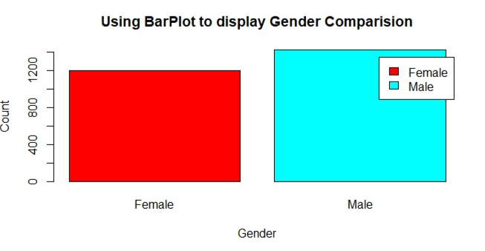
Gender Comparison

Slide 8
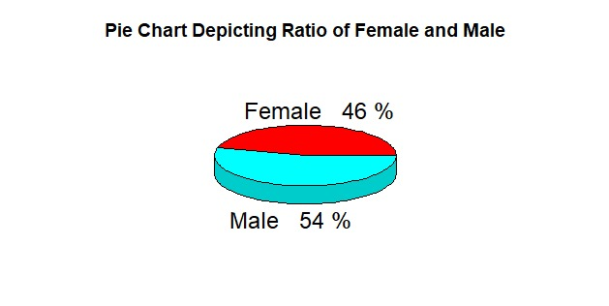
Ratio of Female and Male

Slide 9
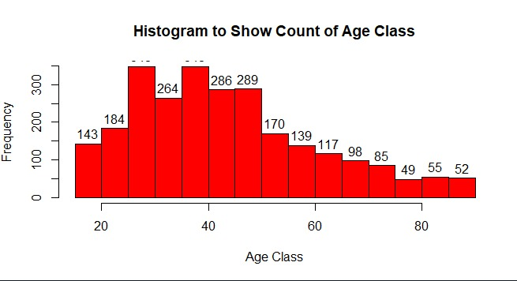
DATA VISUALIZATION AGE DISTRIBUTION

Slide 10
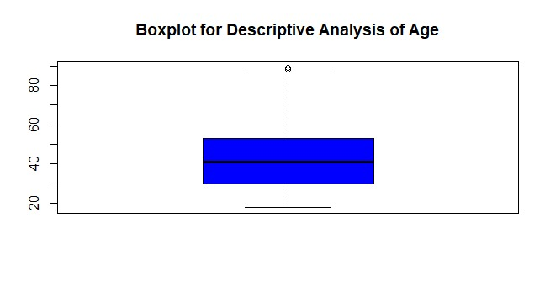
Boxplot for Descriptive Analysis of Age

Slide 11
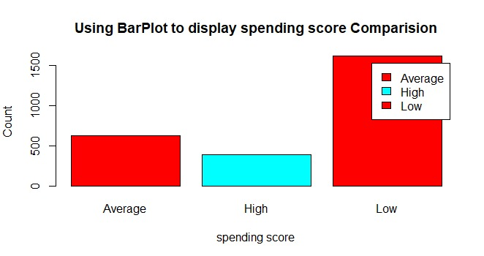
Score Comparison

Slide 12
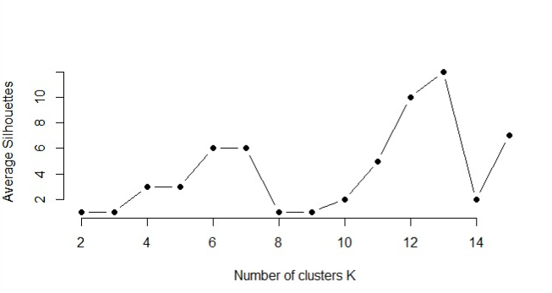
Cluster in K

Slide 13
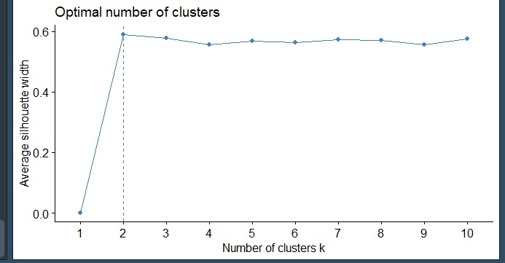
Optimal Number of Clusters

Slide 14
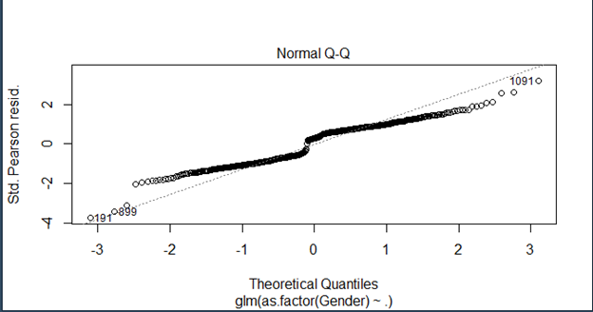
Theoretical Quantiles

Slide 15
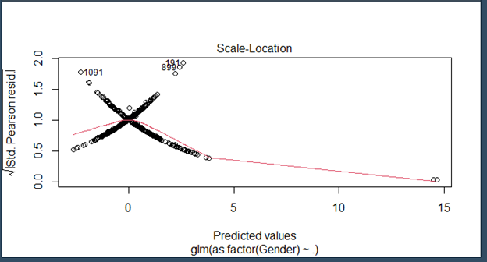
Predicted Values

Slide 16
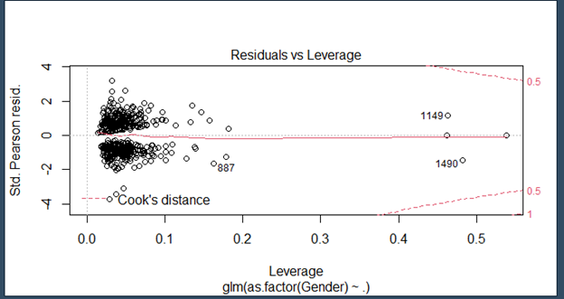
Residuals vs Leverage

Slide 17
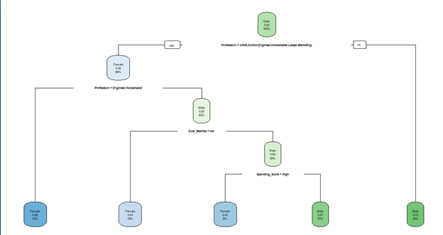
Decision Tree

Slide 18
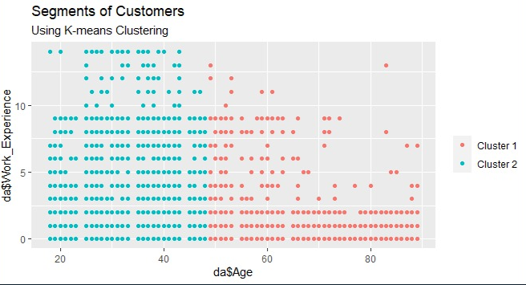
Segments of Customers

Slide 19
CONCLUSION
Customer segmentation is a way to improve communication with the customer, to know the wishes of the customer, customer activity so that appropriate communication can be built. Customer Segmentation needed to get potential customers used to increase profits. Potential customer data can be used to provide service the characteristics of customer including ecommerce services as a media buying and selling online. This paper discusses several components to do customer segmentation, Customer segmentation is an activity to divide customers or item into groups that have the same characteristics. Data that needed for customer segmentation are internal data and external data. The internal data include demographic data and data purchase history, while the external data include cookies and server logs. Internal data can be obtained from a database when customer do registration or transactions and external data can be obtained from web server or other source.

Slide 20
REFERENCE
https://www.google.com/amp/s/www.intercom.com/blog/customer-segmentation/%3famp
https://www.mycustomer.com/hr-glossary/customer-segmentation
https://www.yieldify.com/blog/types-of-market-segmentation/

Slide 21


